Slide 1
Openocd debugging

Slide 2
What we will cover
A short demo of adding breakpoints in action
Introducing the FT2232
Overview on how it works
Wiring it all up
Configuring and activating break points

Slide 3
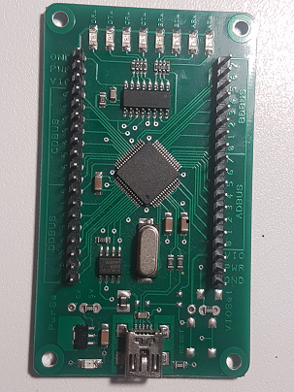
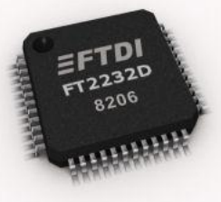
Introducing the FT2232
Data sheet https://www.ftdichip.com/Support/Documents/DataSheets/ICs/DS_FT2232D.pdf
Getting a dev board

Slide 4
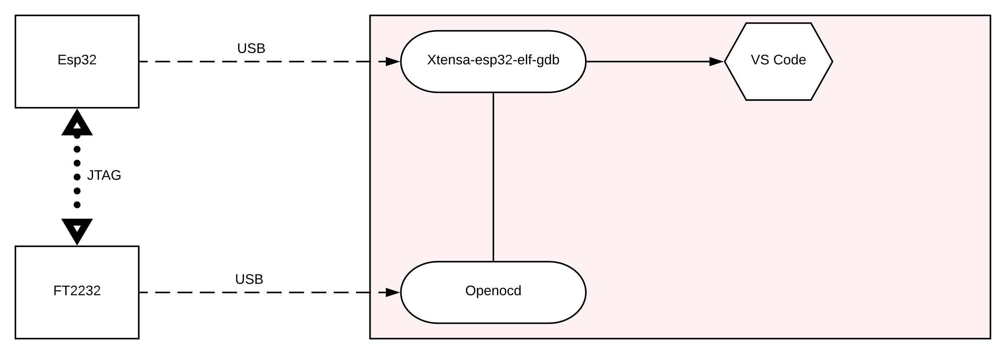
Overview on how it works

Slide 5
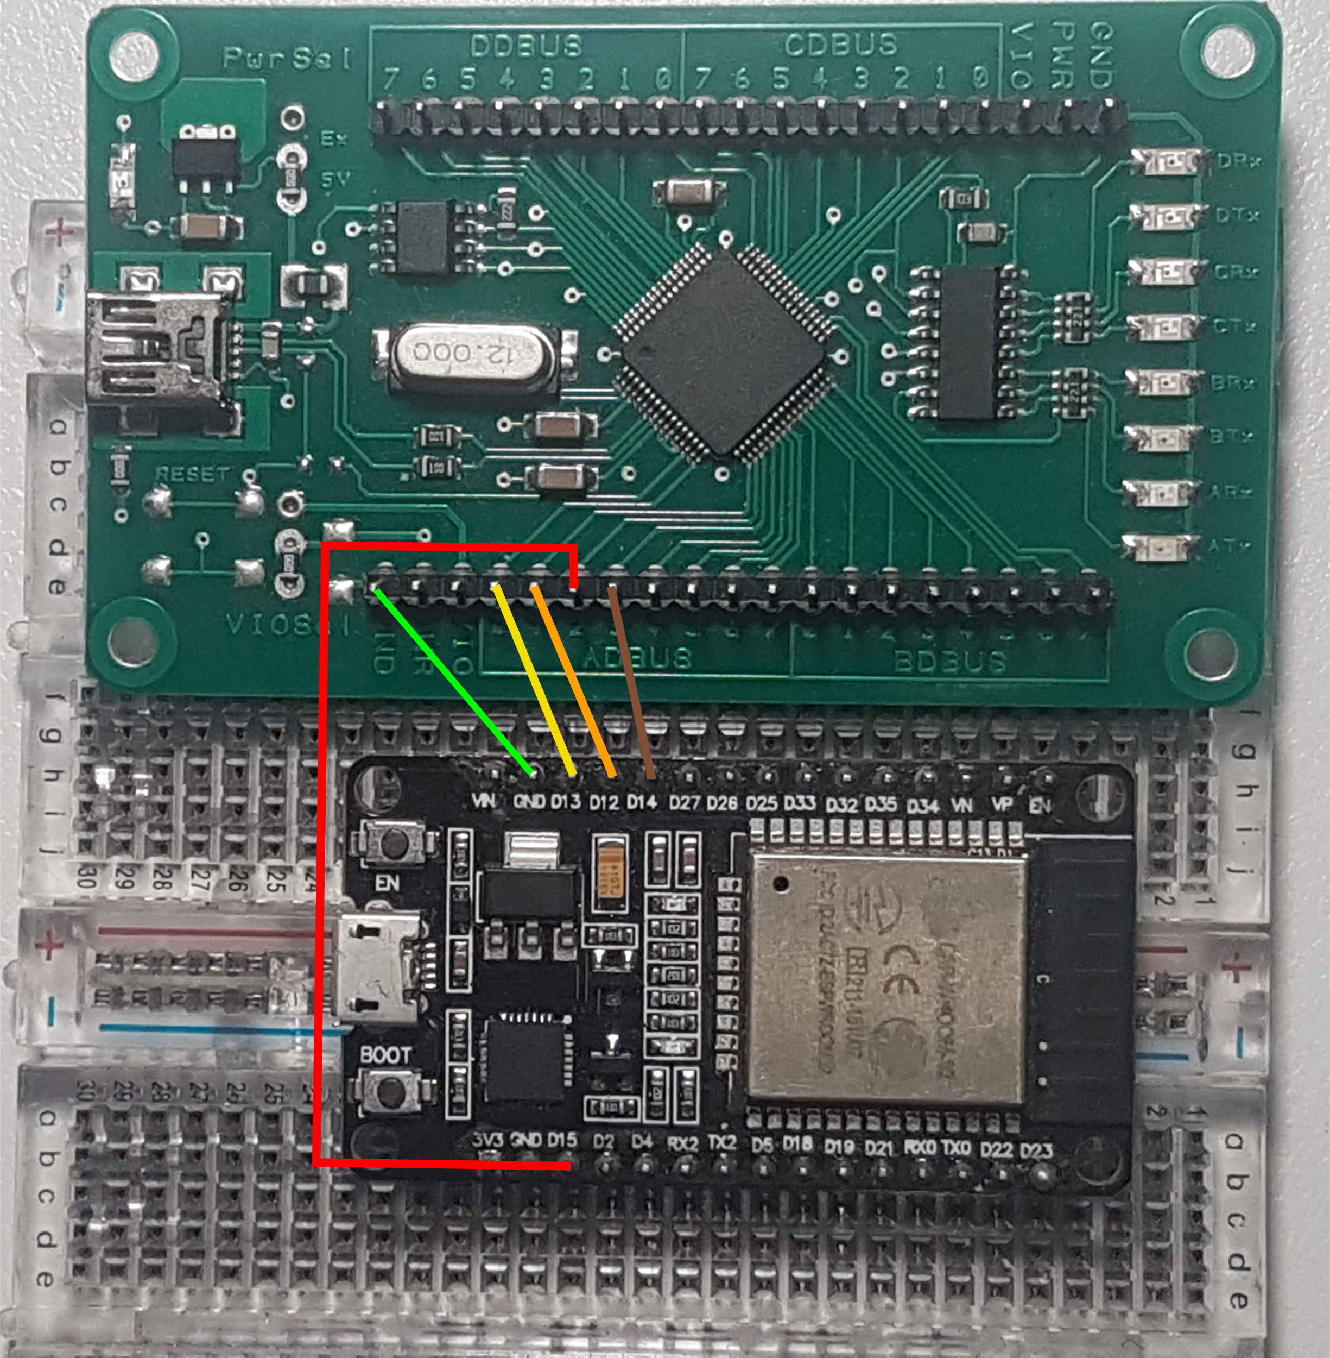
Wiring it all up
FT2232 |  | ESP32
Pin Name | Pin Number | Pin Number | Pin Name
TCK | ADBUS 0 | 13 | MTCK
TDI | ADBUS 1 | 12 | MTDI
TDO | ADBUS 2 | 15 | MTDO
TMS | ADBUS 3 | 14 | MTMS
GND |  | GND

